Slide 1
CSCI 331 – Group 9-4 Project 3
Members: Rajveer Singh (Group-Leader), Meet Patel (Backup- Leader), Eliyahu Roth, Edison Enerio, Mashiur Rahman

Slide 2
Project Management
This section will entail all aspects of project management in this presentation
The project plan
Meeting Notes
Use of Redgate Tool belt
Screenshots of all To-Do Lists
Screenshots the Gannt Chart
Details of groups assistance with each other

Slide 3
The Project Plan
In this project our group did this in two phases. Planning and Implementation
For planning out group members came together to discuss how the project will be completed and organized and discussed so everyone is on the same page
After planning is complete implementing begins and all due dates and assignments are tasked for project workflow to be linear

Slide 4

Meeting Notes
For this project we did not have any “official” meetings however there were multiple times where group members discussed things over chat and over voice call in discord to collaborate and help each other with tasks and or issues regarding their work for the project.
We used Discord and created threads for organization of our discussions

Slide 5
Use of Redgate
We used SQL Prompt for autofill purposes when writing queries
We also used the object explorer to navigate our database
Used Redgate to create PDF Documentation for finalized database

Slide 6
To-Do Lists

Slide 7
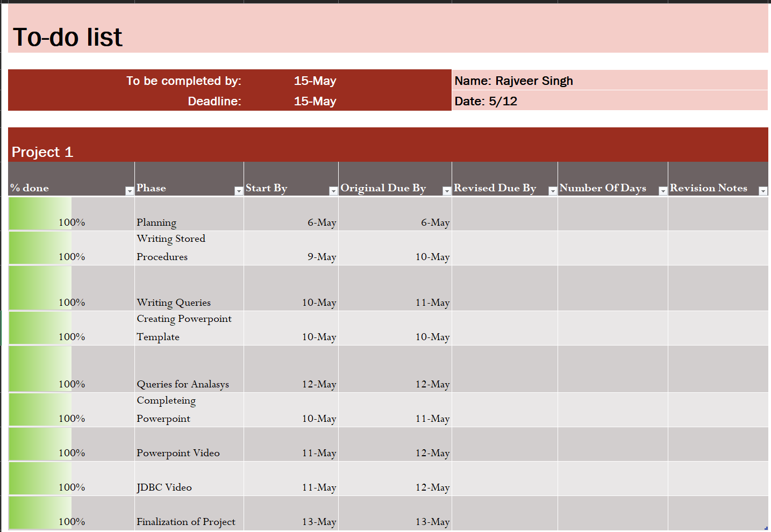
To-Do List: Rajveer Singh

Slide 8
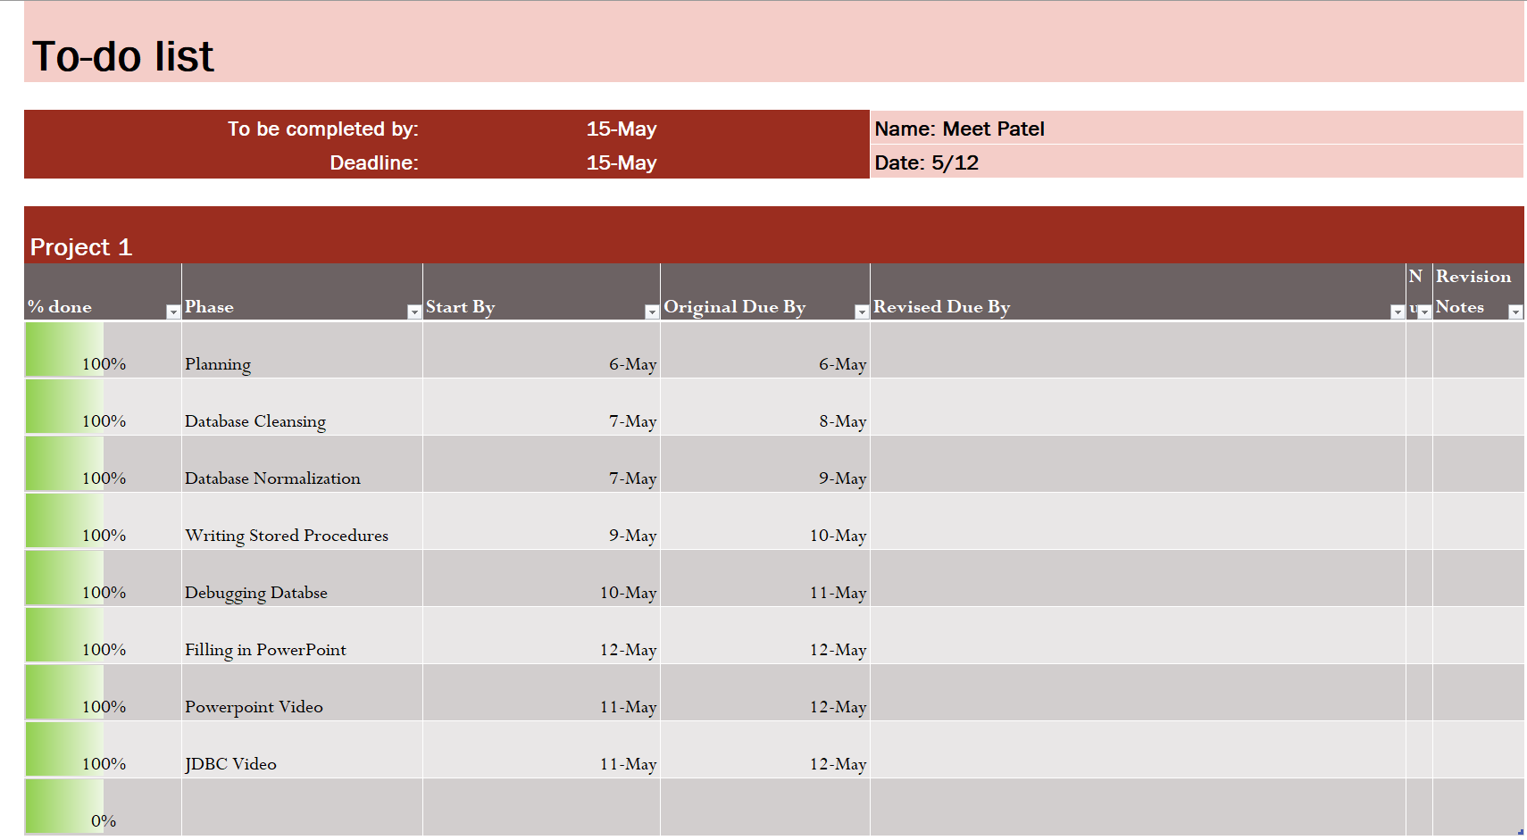
To-Do List: Meet Patel

Slide 9
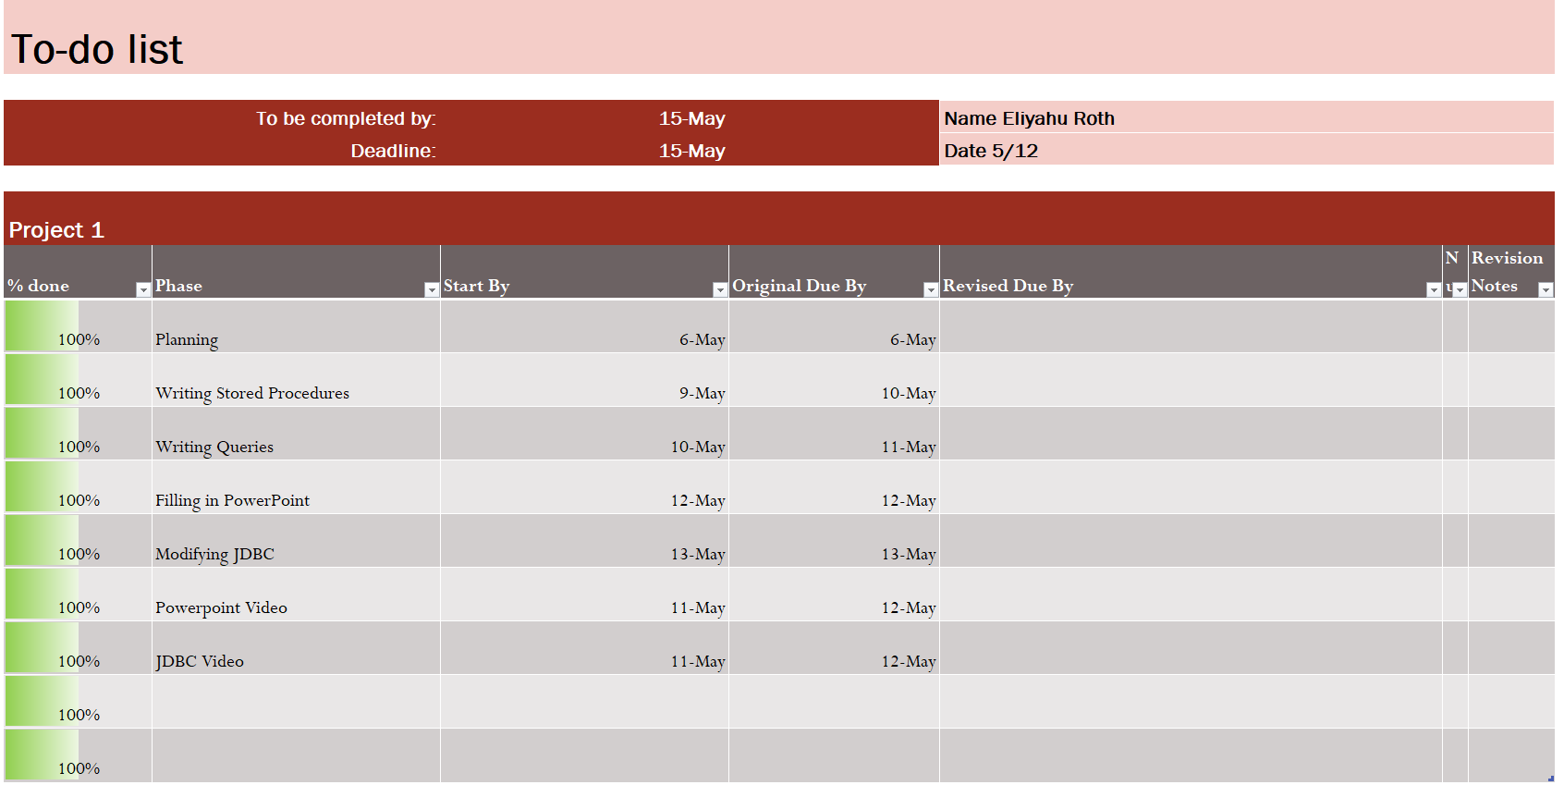
To-Do List: Eliyahu Roth

Slide 10
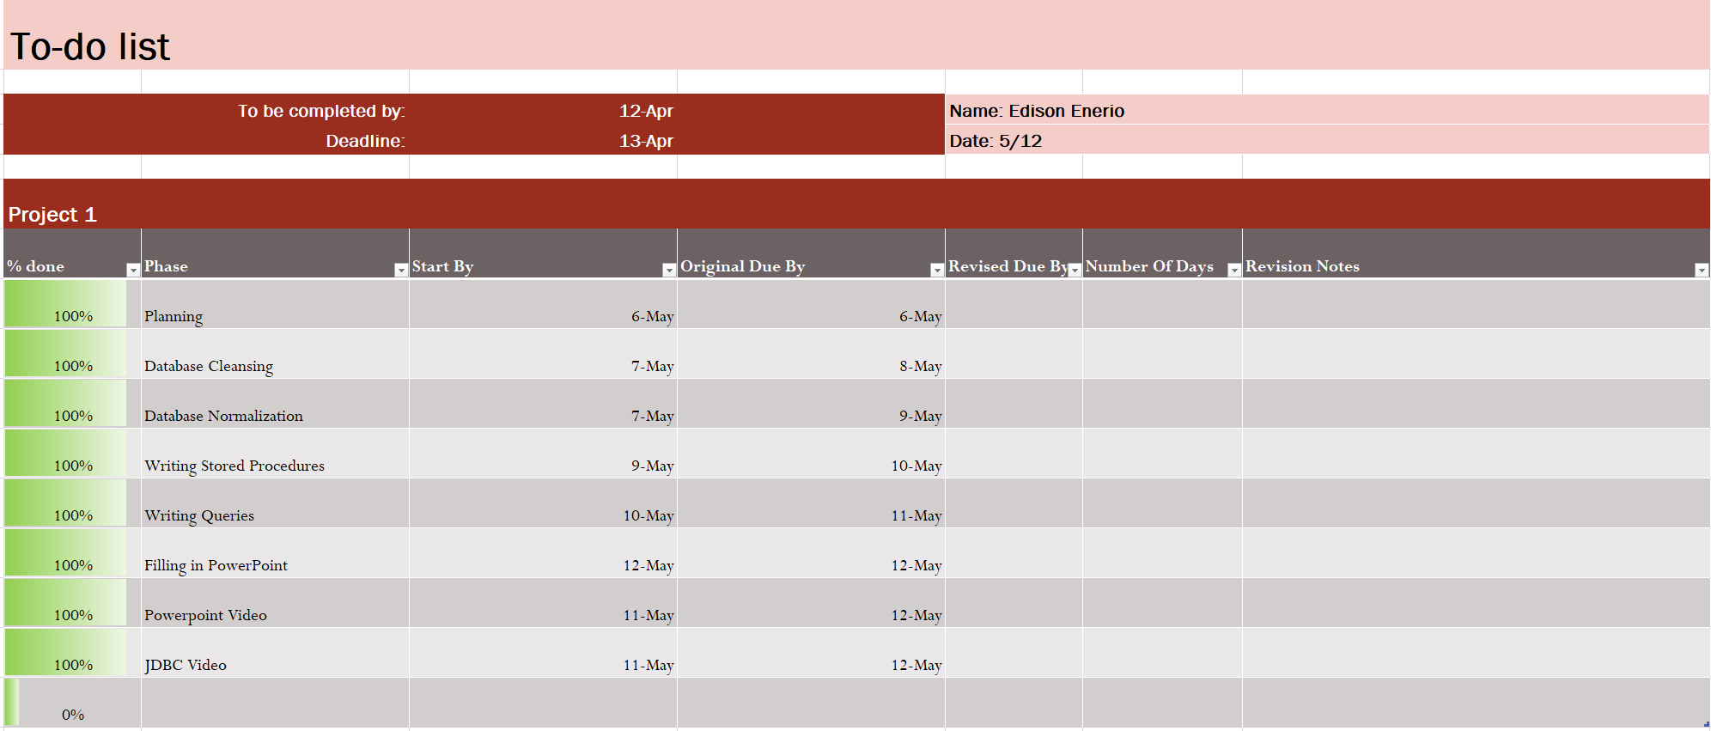
To-Do List: Edison Enerio

Slide 11
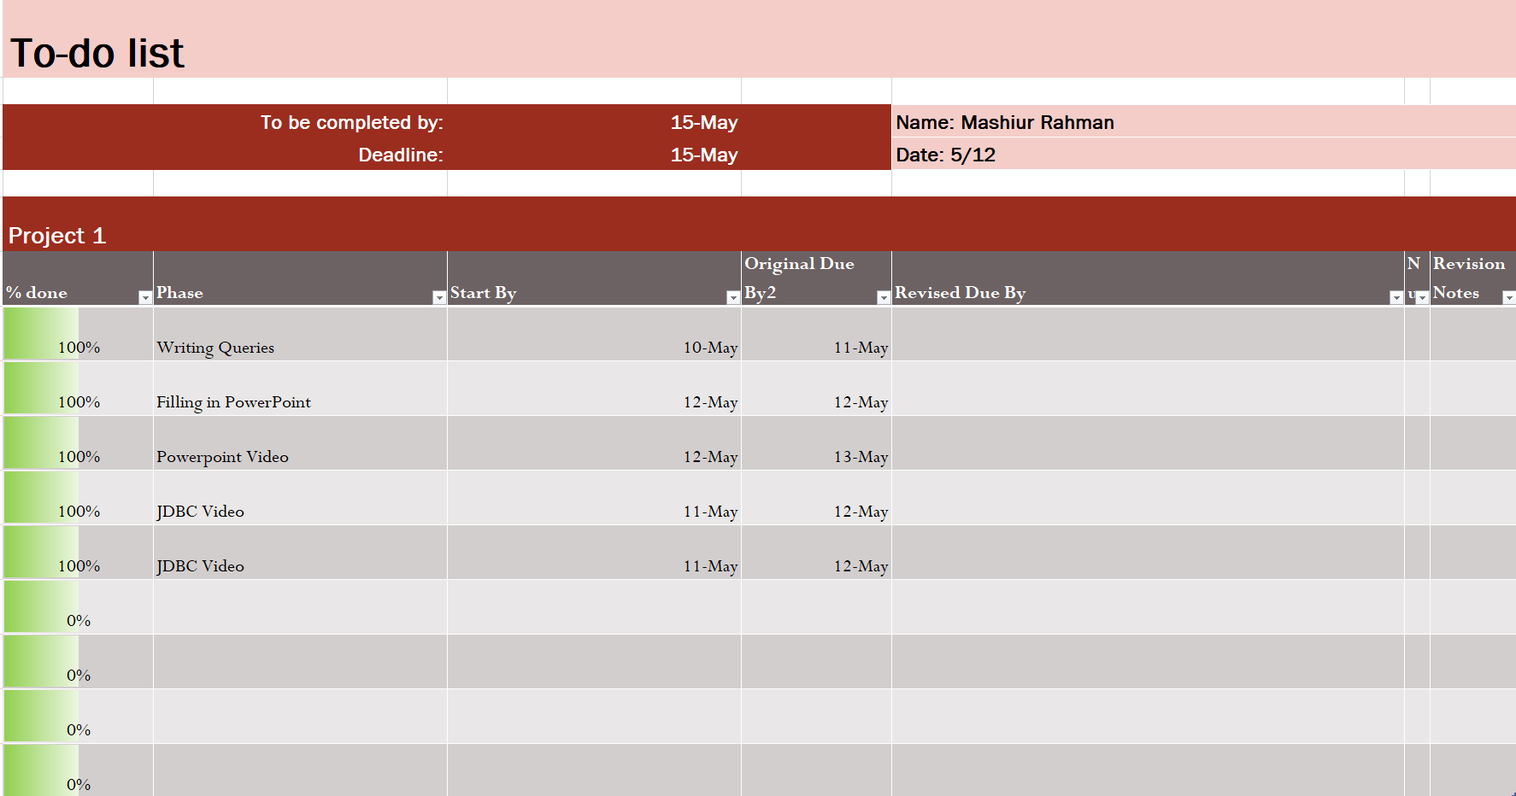
To-Do List: Mashiur Rahman

Slide 12
Gannt Chart

Slide 13
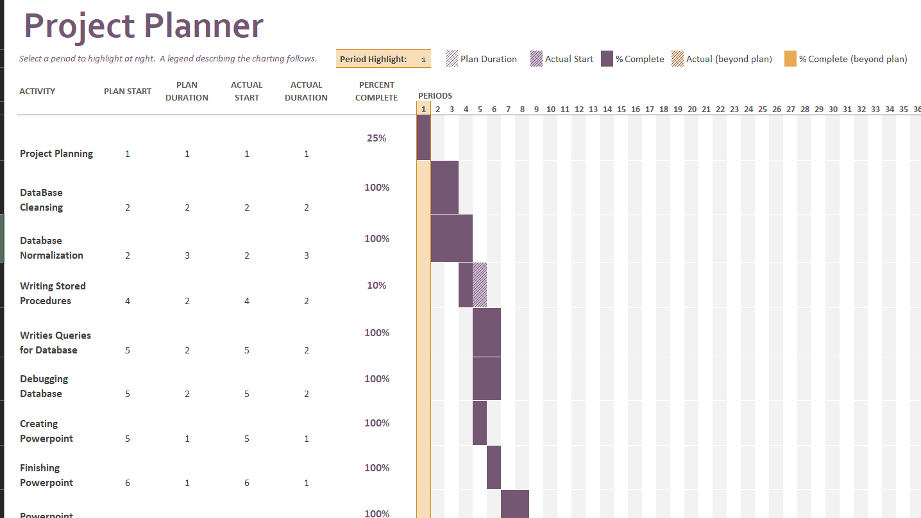

Slide 14
Project Management END

Slide 15
DbSecurity.UserAuthorization Process.WorkFlowSteps

Slide 16
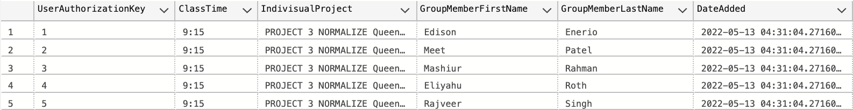
DbSecurity.UserAuthorization

Slide 17
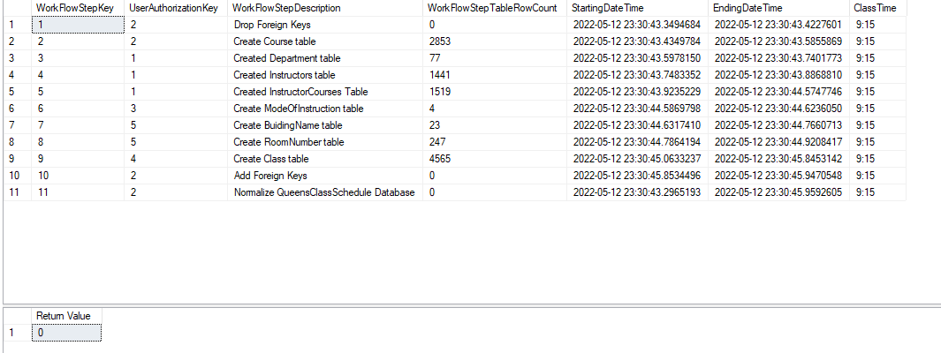
Process.WorkFlowSteps

Slide 18
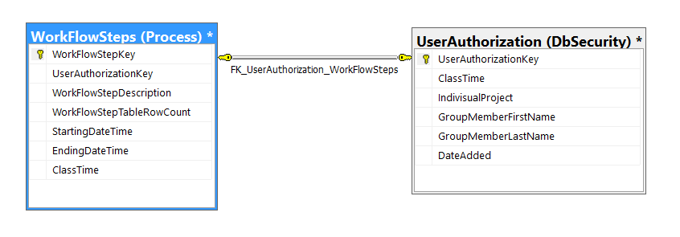
ERD of WFS and UserAuthorization

Slide 19
Database Overview

Slide 20
Database Normalization
Design:
Create query for the bad data.
Create query to pull good data using bad data.
See what data needed to be separated.
Create functions to separate data (part of normalizing the good data table).
See what tables could be formed from the normalized table.

Slide 21
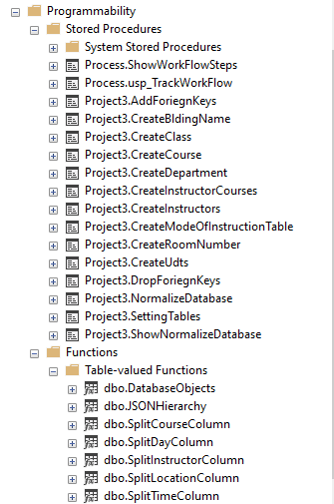
All Procedures and Function

Slide 22
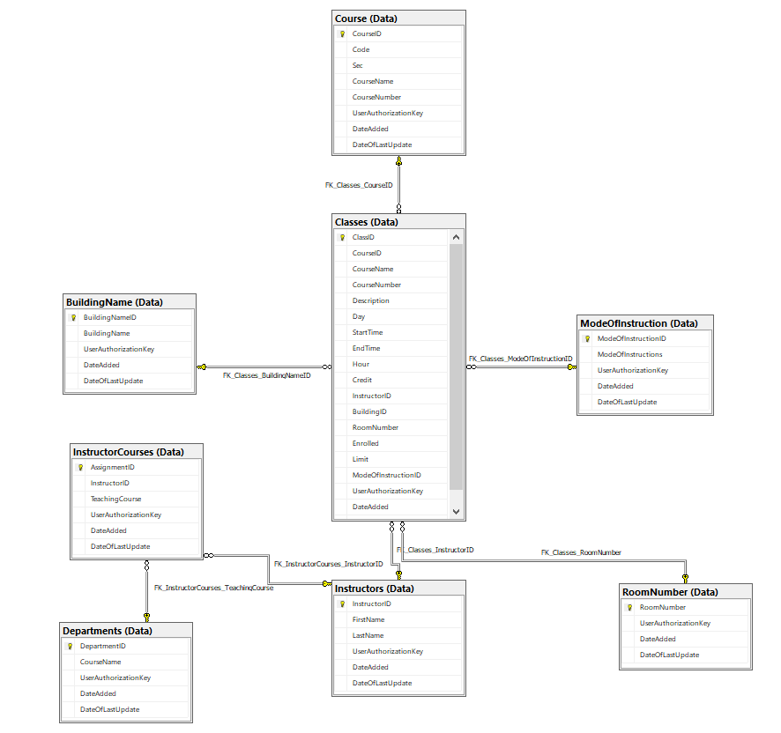
Database ERD

Slide 23
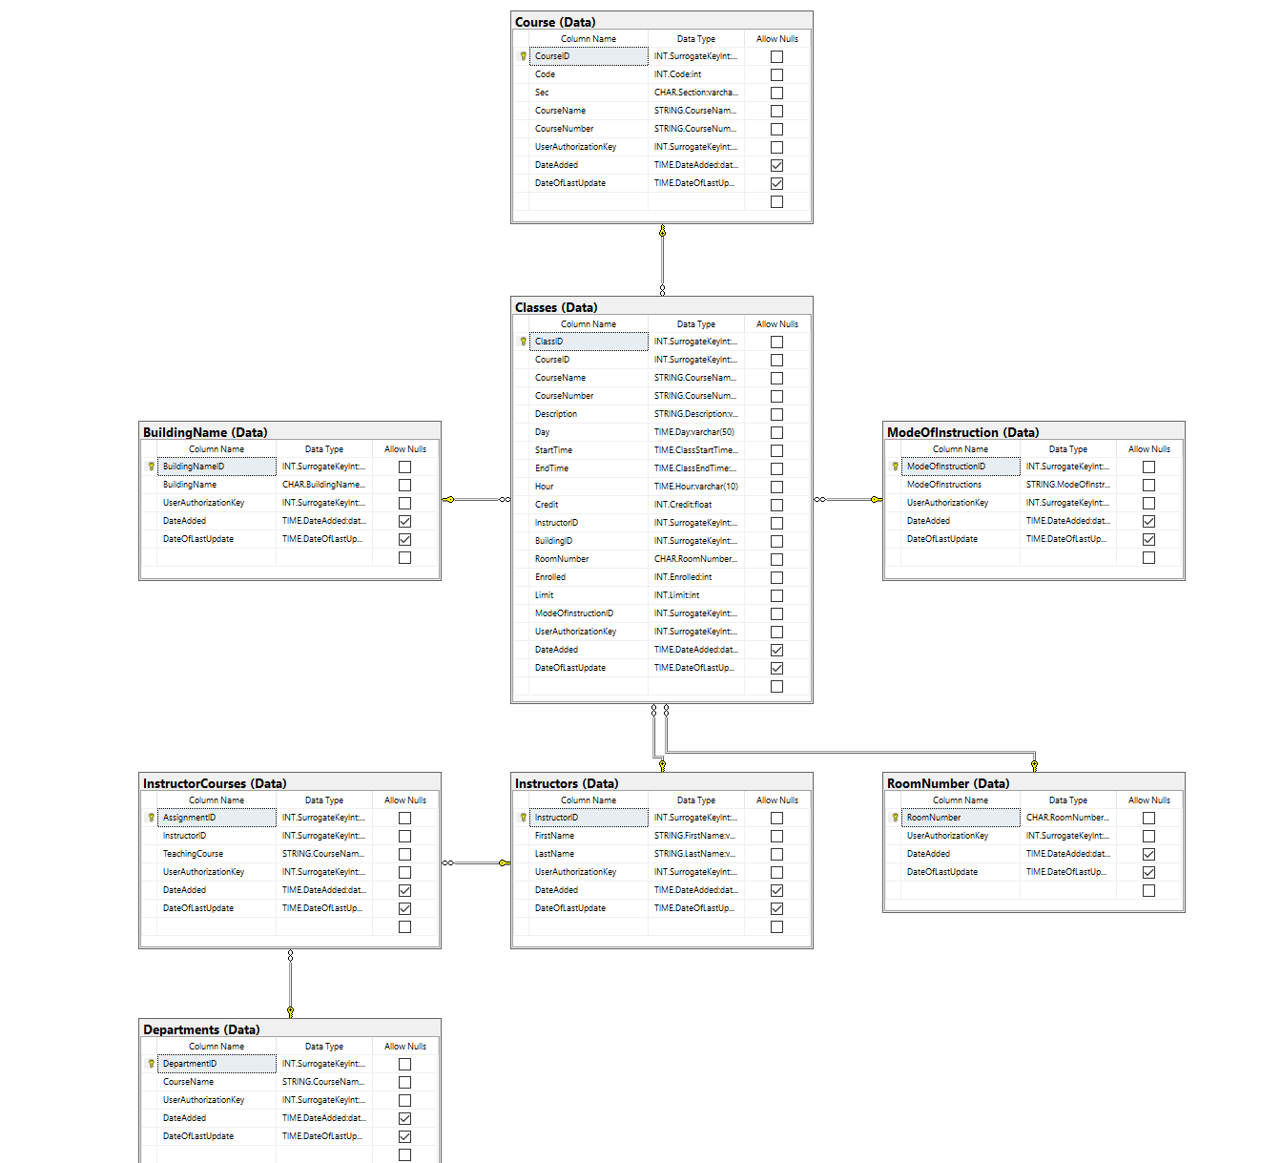
Database PDM

Slide 24
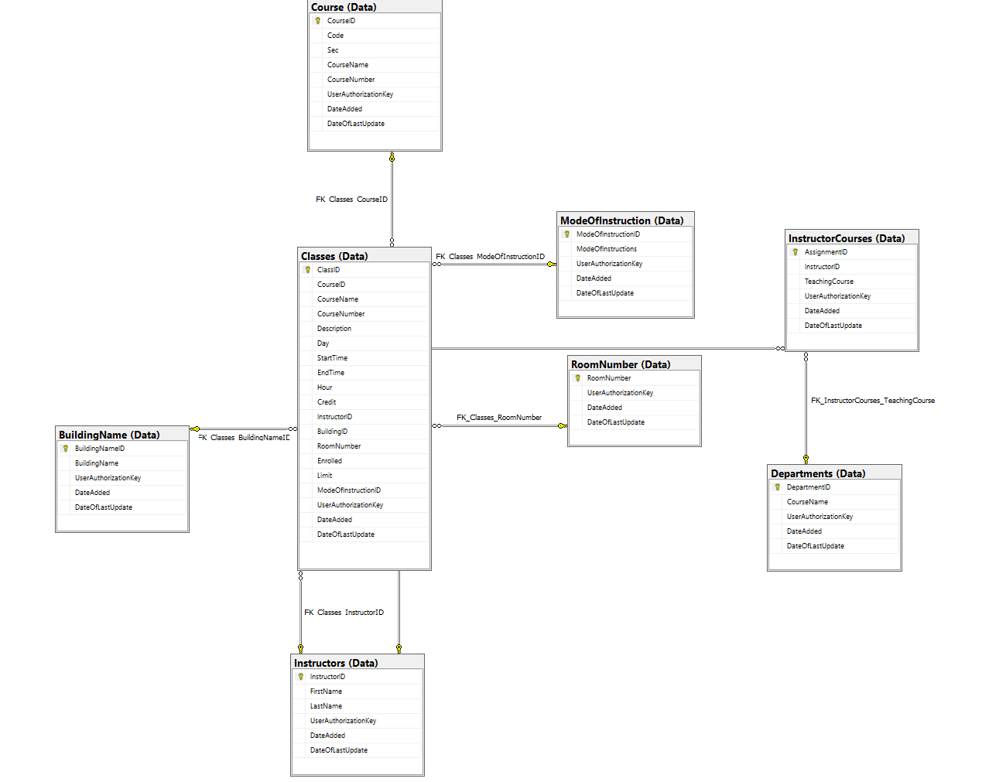
Database LDM

Slide 25
Data Cleansing

Slide 26
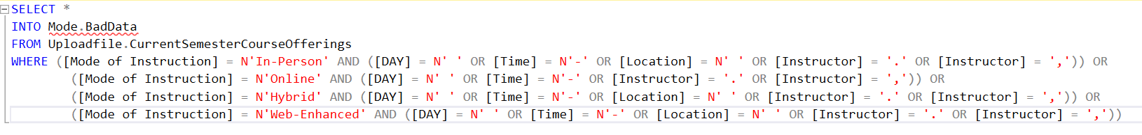
Getting Bad Data

Slide 27
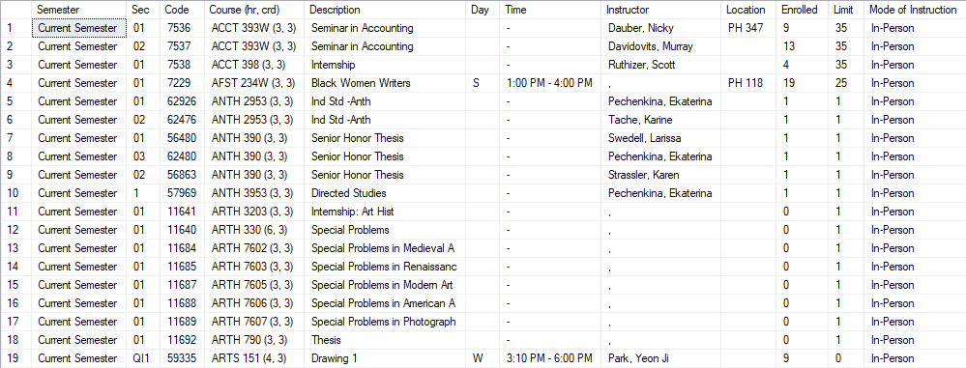
Output

Slide 28
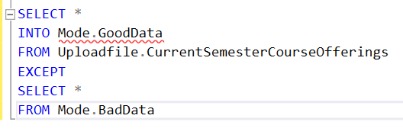
Getting Good data

Slide 29
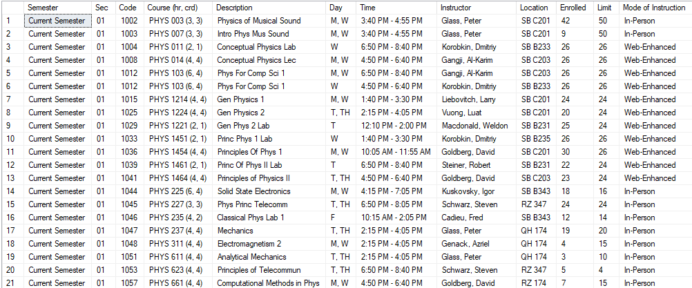
Output

Slide 30
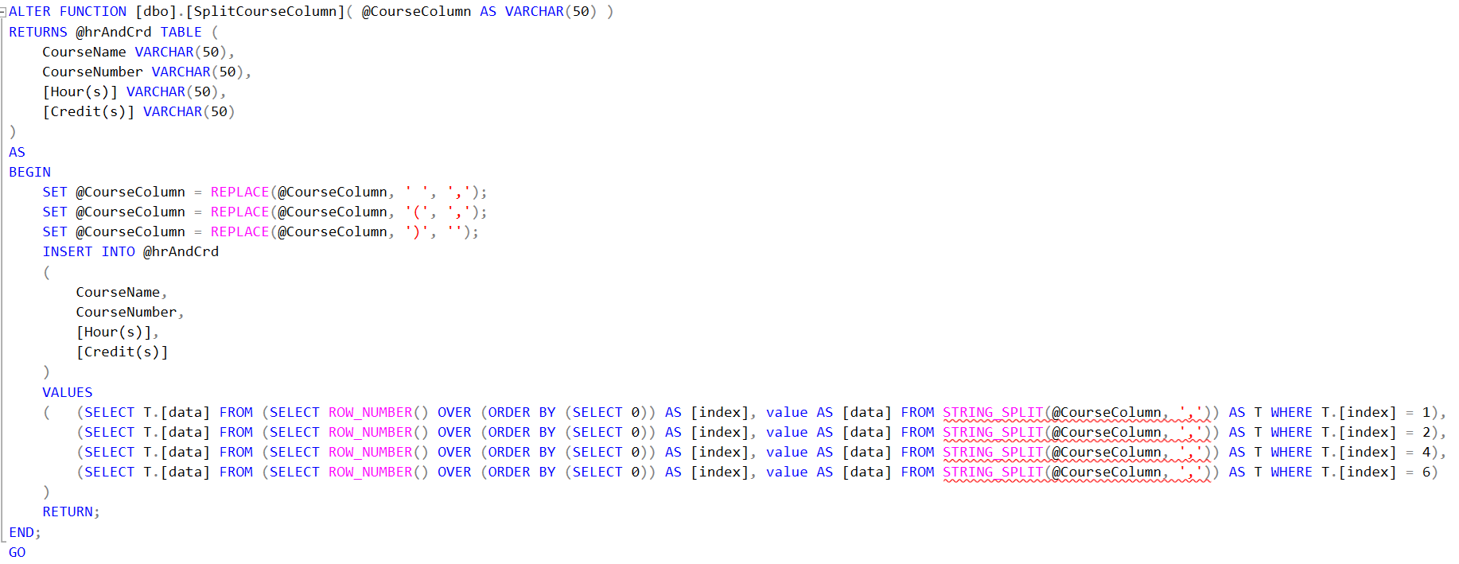
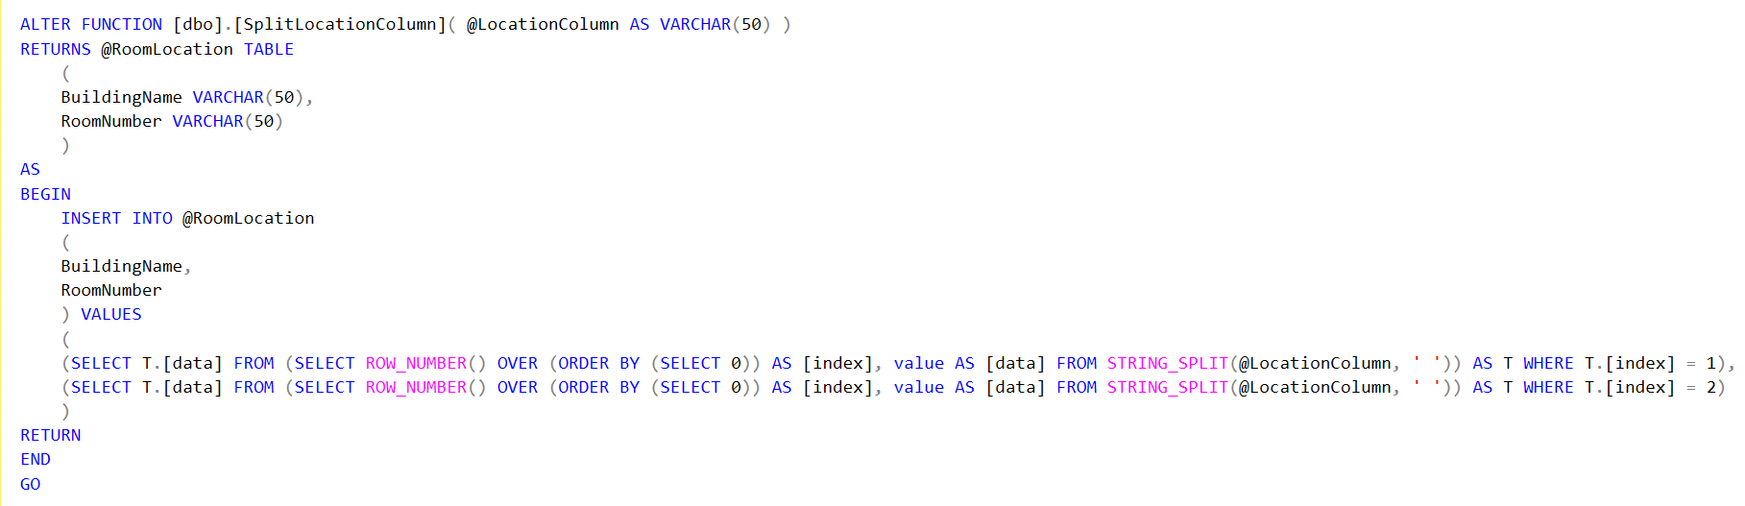
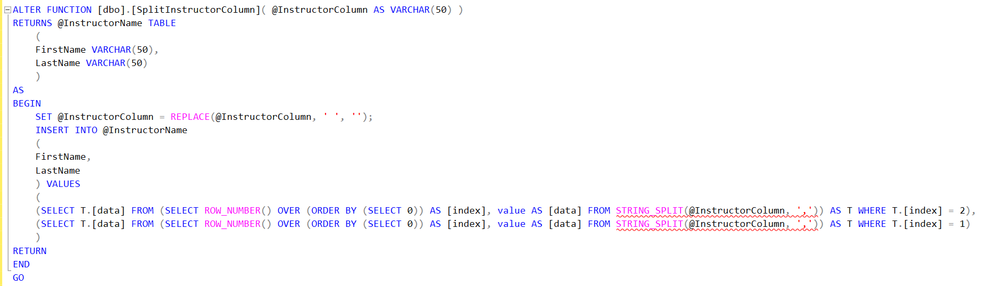
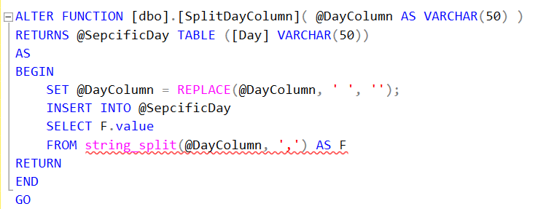
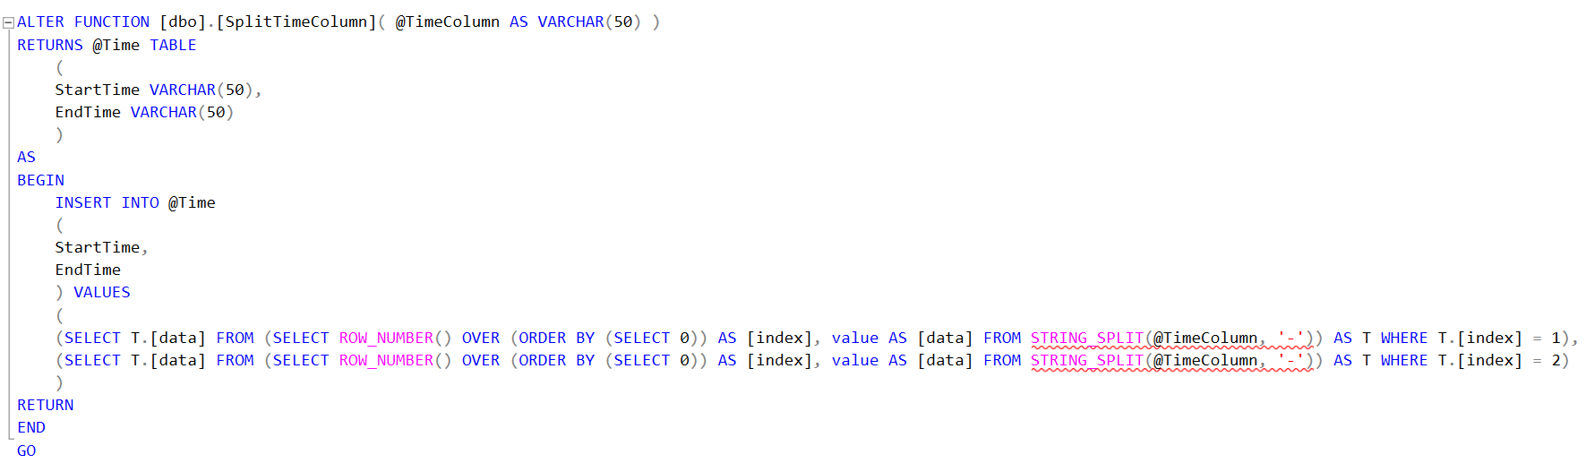
Functions and TVF

Slide 31
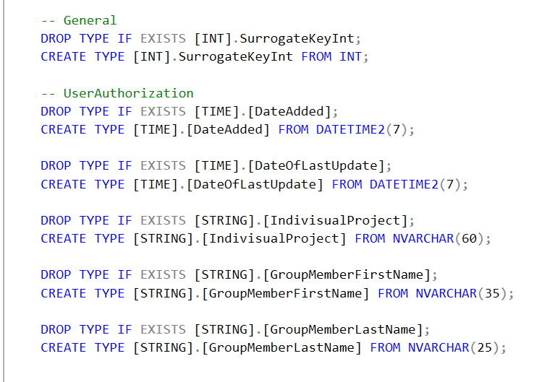
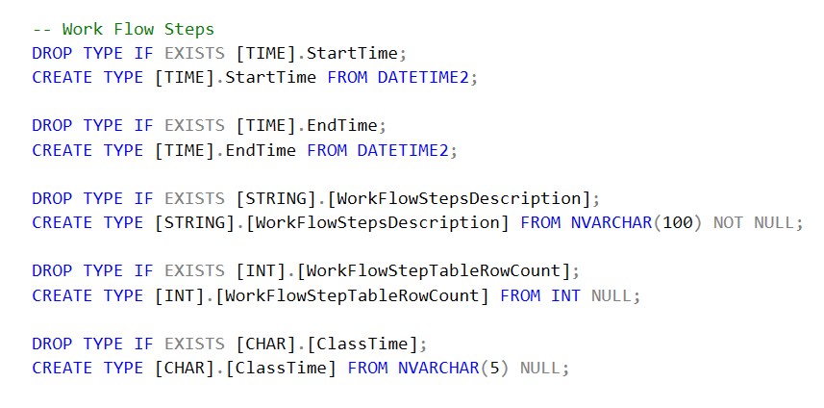
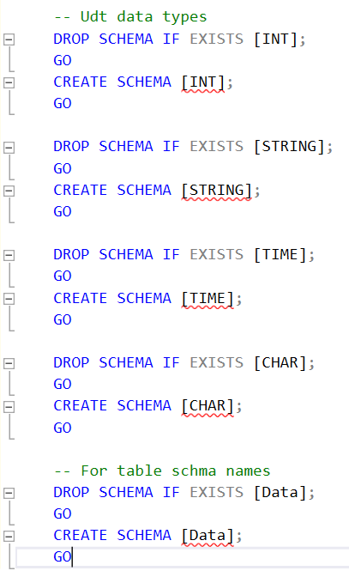
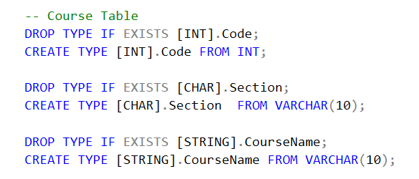
UDT Listing
Schema names were repeated to make naming consistent.
While using the NorthWinds style was asked using just Udt.Column name didn’t seem descriptive enough, so separate schema names were used.

Slide 32
Stored Procedures

Slide 33
Meet Patel Procedures
Process.ShowWorkFlowSteps
Process.usp_TrackWorkFlow
Project3.CreateUDTs
Project3.SettingTables
Project3.ShowNormalizedDatabase
Project3.DropForeignKeys
Project3.NormalizingDatabase
Project3.AddForeignKeys
Project3.CreateCourse
Project3.CreateModeOfInstructionTable
Project3.CreateRoomNumber

Slide 34
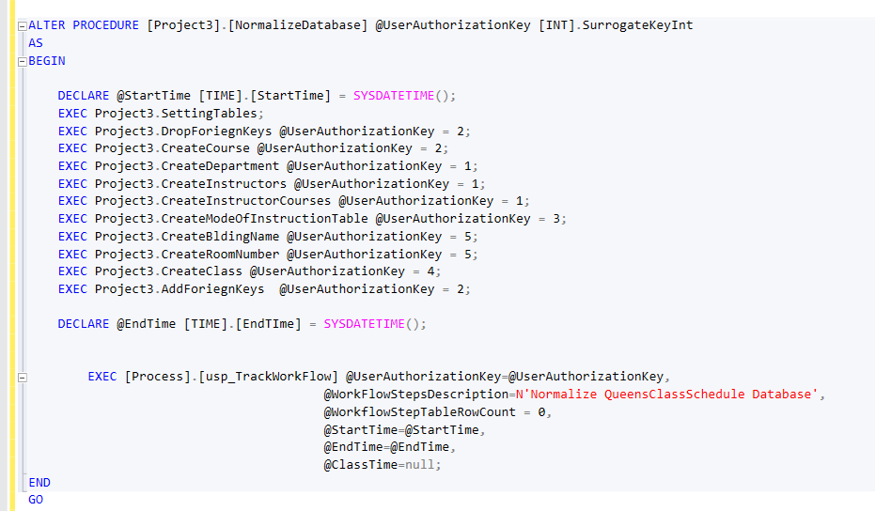
Project3. NormalizingDatabase

Slide 35
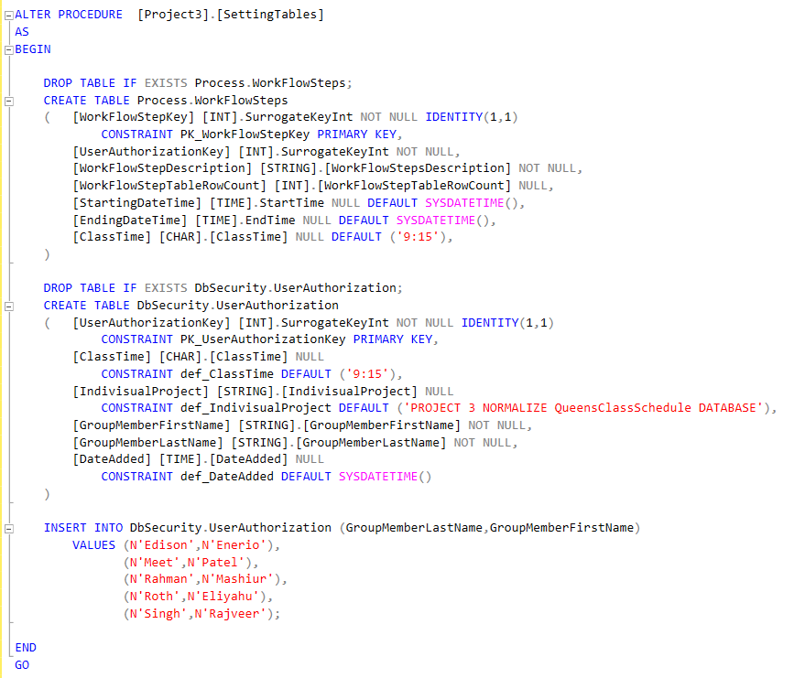
Project3. SettingTables

Slide 36
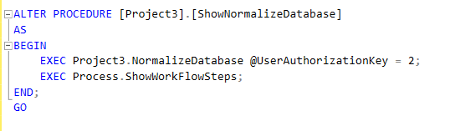
Project3. ShowNormalizedDatabase

Slide 37
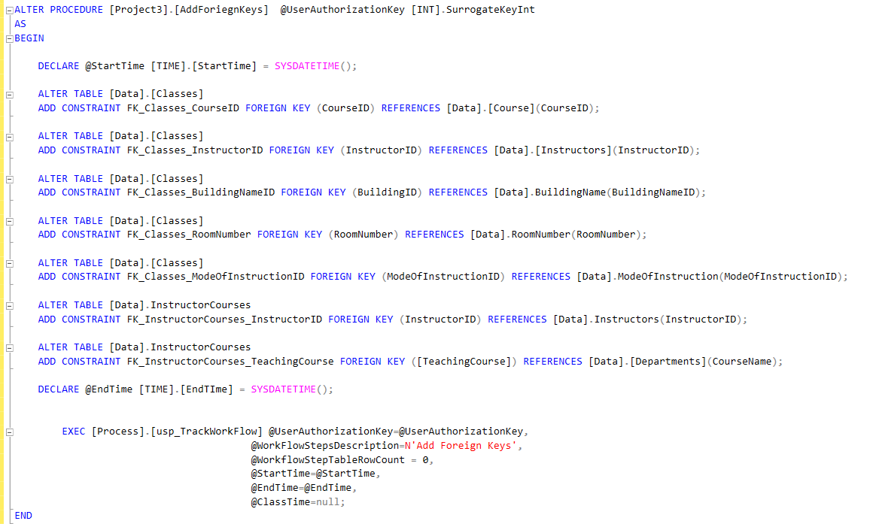
Project3. AddForeignKeys

Slide 38
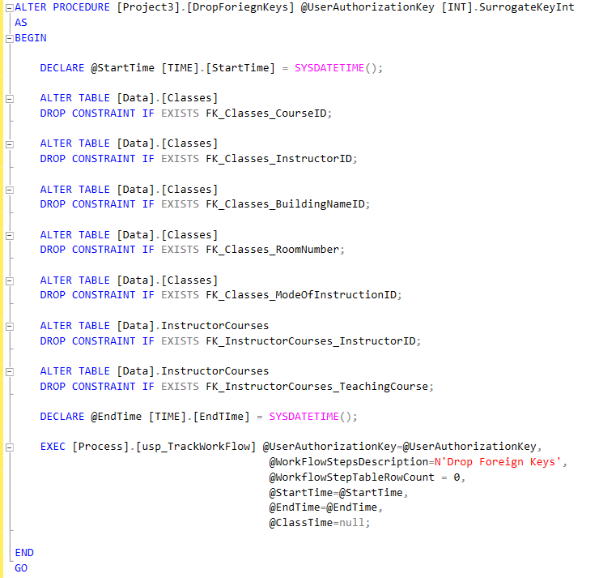
Project3.DropForeignKeys

Slide 39
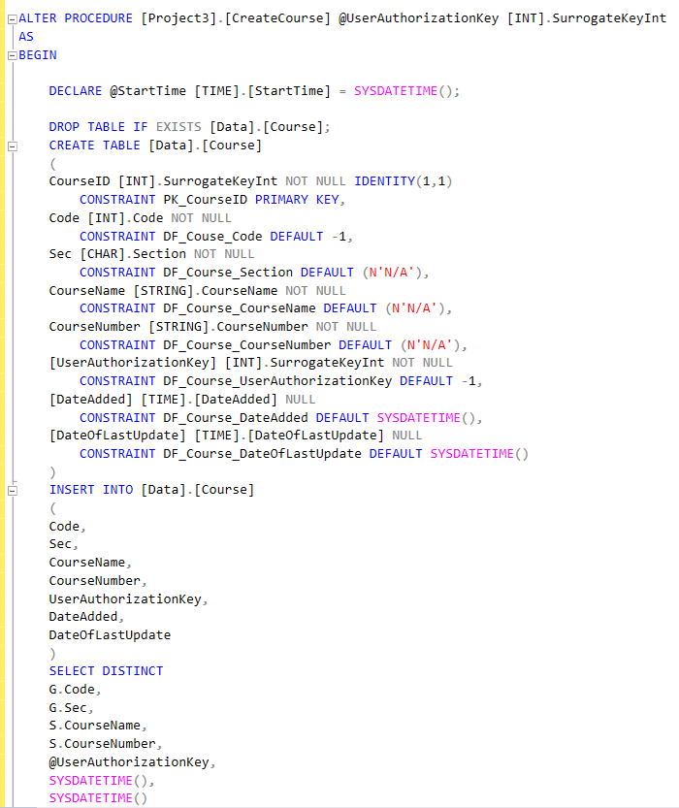
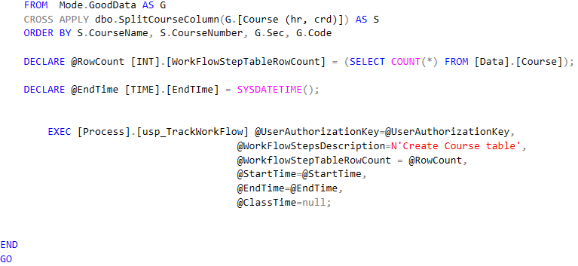
Project3. CreateCourse

Slide 40
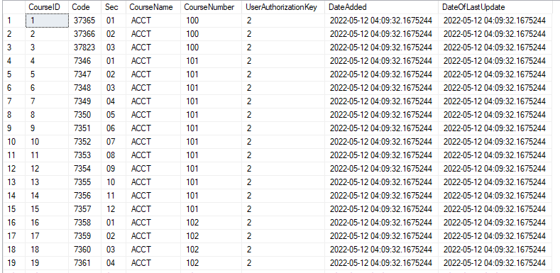
Output

Slide 41
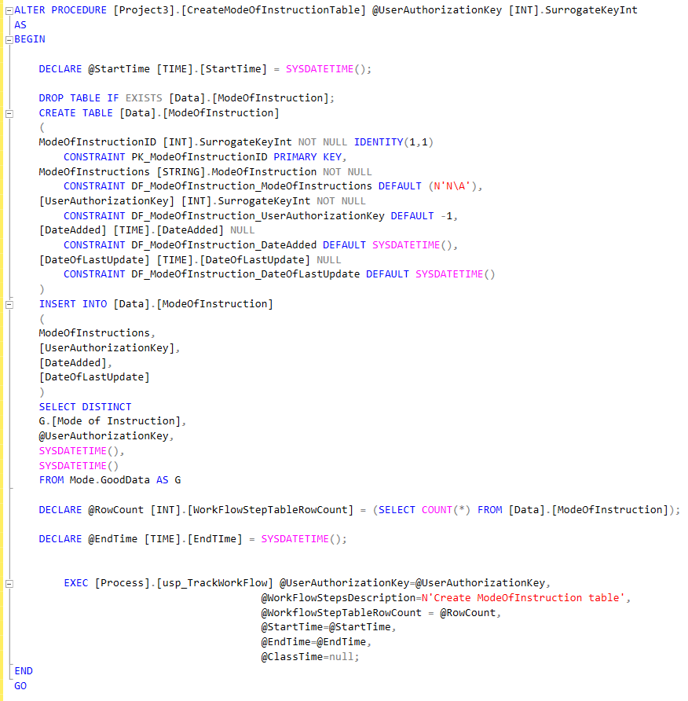
Project3. CreateModeOfInstructionTable

Slide 42
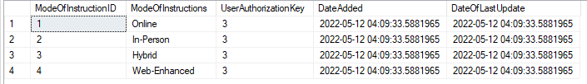
Output

Slide 43
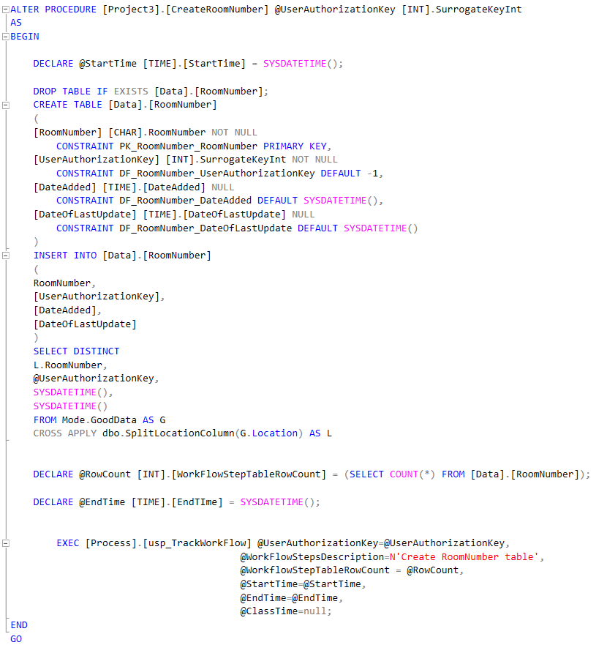
Project3. CreateRoomNumber

Slide 44
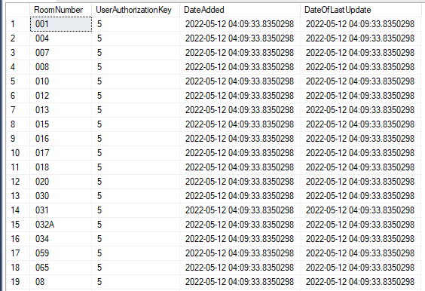
Output

Slide 45
Rajveer Singh Procedures
Project3.CreateBuildingName

Slide 46
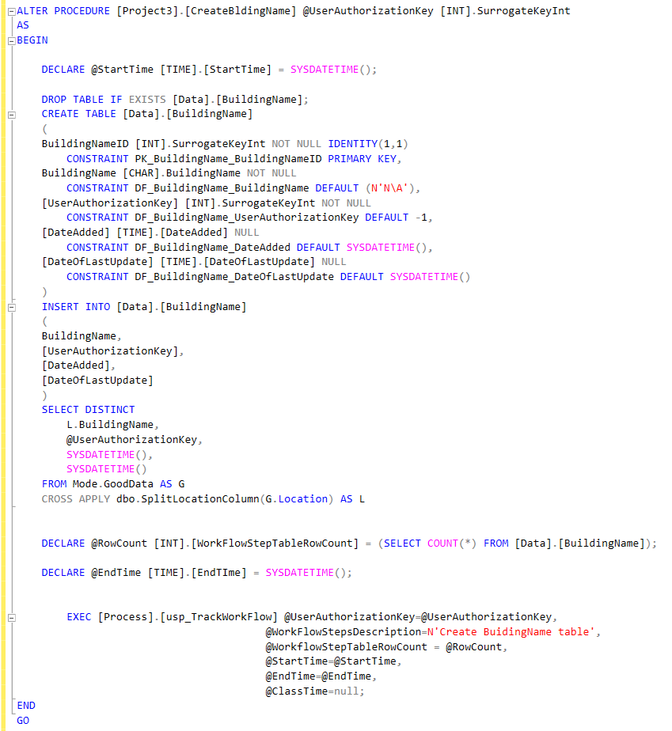
Project3.CreateBuildingName

Slide 47
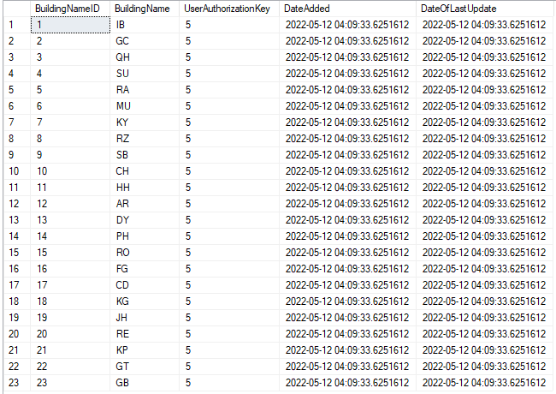
Output

Slide 48
Edison Enerio Procedures
Project3.CreateDepartment
Project3.CreateInstructor
Project3.CreateInstructorCourse

Slide 49
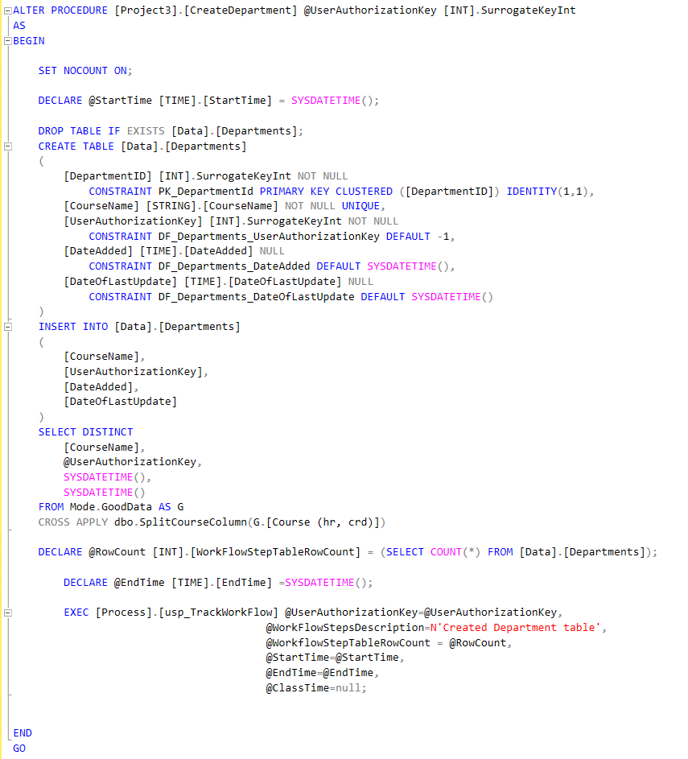
Project3.CreateDepartment

Slide 50
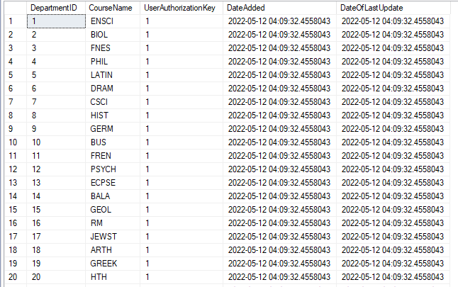
Output

Slide 51
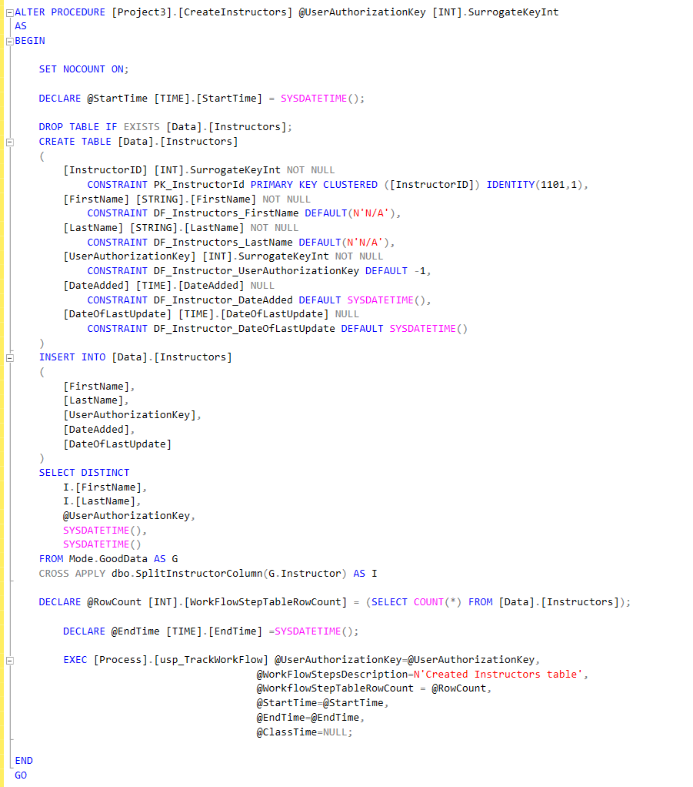
Project3.CreateInstructor

Slide 52
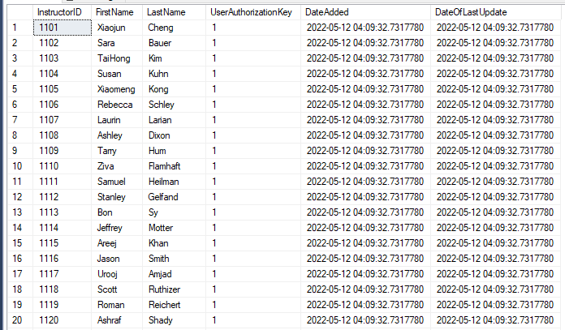
Output

Slide 53
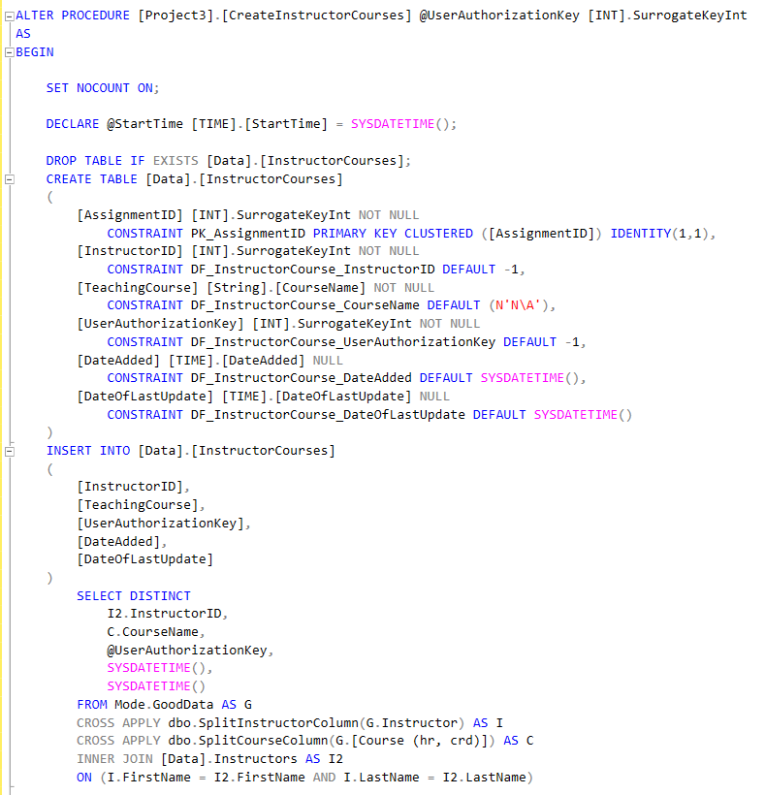
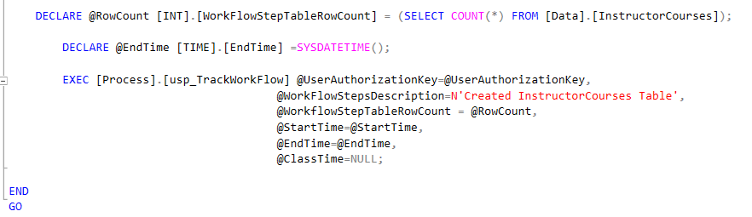
Project3. CreateInstructorCourse

Slide 54
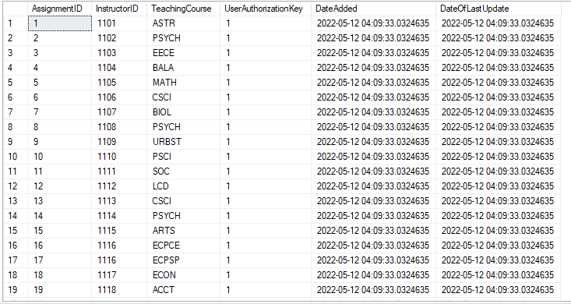
Output

Slide 55
Eliyahu Roth Procedures
Project3.Class

Slide 56
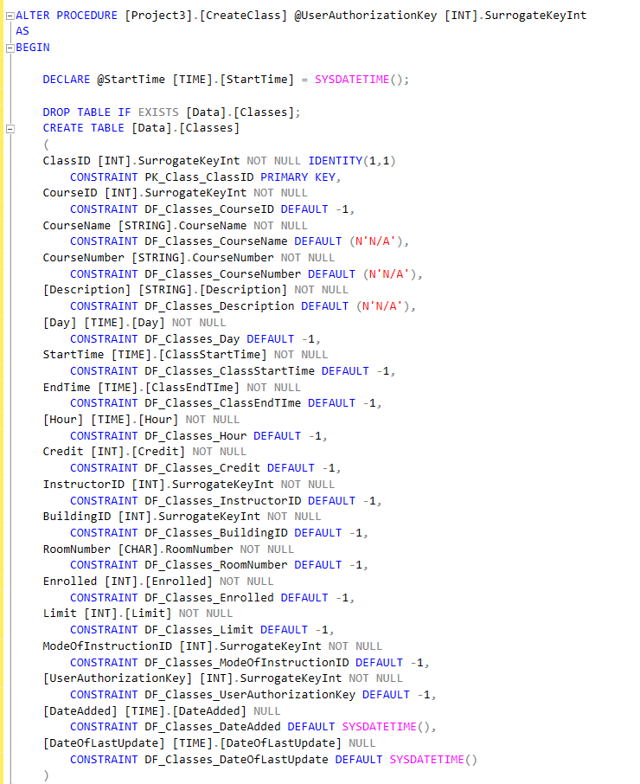
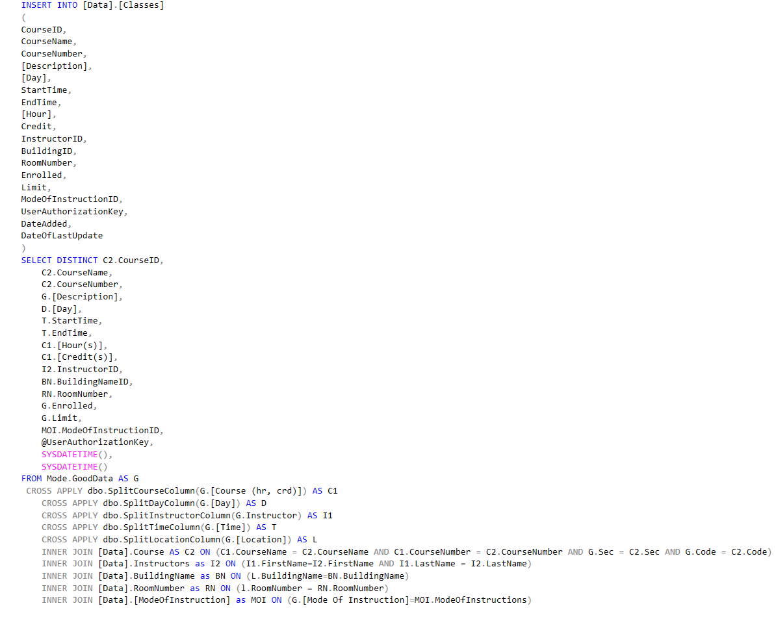
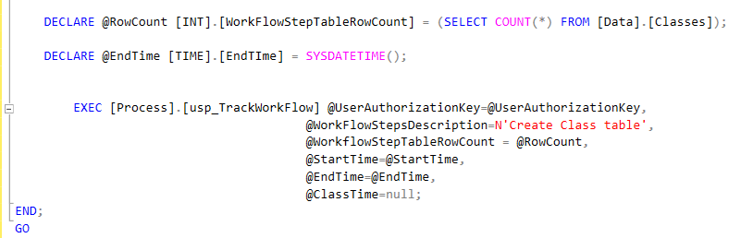
Project3.Class

Slide 57

Output

Slide 58
Queries

Slide 59
Rajveer Singh Queries
4 Personal Queries

Slide 60

Query #1
List the name of all the instructors that teach in the science building and their room numbers from highest to lowest

Slide 61

Output

Slide 62

Query #2
Find the total number of teaching in each building that are teaching Physics

Slide 63

Output

Slide 64

Query #3
Which professor teaches the most classes

Slide 65

Output

Slide 66

Query #4
Show the length of time for all computer science classes that are In Person

Slide 67

Output

Slide 68
Eliyahu Roth Queries
How may classes that are being taught that semester grouped by course and aggregating the total enrollment, total class limit and the percentage of enrollment.
2. Personal Queries

Slide 69
Query
--How may classes that are being taught that semester grouped by course and aggregating the total enrollment, total class limit and the percentage of enrollment.
SELECT [CourseName], CourseNumber, SUM(Enrolled) as [Total Enrolled], Sum([Limit]) as [Total Limit], Case
WHEN (SUM([Limit]) != 0 ) then CAST(Sum(Enrolled) as numeric)/CAST(SUM([Limit]) as numeric)*100
Else -1
END as [Percentage Enrolled]
FROM [QueensClassSchedule].[Data].[Classes]
GROUP BY CourseName, CourseNumber
Order by CourseName, CourseNumber

Slide 70

Output

Slide 71
Query
--How many classes are each instructor teaching?
Select I.FirstName, I.LastName, COUNT(C.ClassID) as [Number Of Classes Teaching]
From [Data].Classes as C INNER JOIN [Data].[Instructors] as I on (C.InstructorID=I.InstructorID)
GROUP BY C.InstructorID, I.FirstName, I.LastName

Slide 72

Output

Slide 73
Query
--What percentage of the total courses is each mode of instruction?
Select ModeOfInstructions, COUNT(*) as [Number Of Classes Taught], COUNT(*) * 100.0 / SUM(COUNT(*)) OVER () AS [Percentage Of All Classes]
From [Data].Classes as C INNER JOIN [Data].ModeOfInstruction as MOI on (C.ModeOfInstructionID=MOI.ModeOfInstructionID)
GROUP BY C.ModeOfInstructionID, MOI.ModeOfInstructions

Slide 74

Output

Slide 75
Edison Enerio Queries
Show all instructors who are teaching in classes in multiple departments
How many instructors are in each department?

Slide 76
Query
/*
Proposition:
Show all instructors who are teaching in classes in multiple departments
*/
SELECT CONCAT(I.FirstName, ' ', I.LastName) AS Instructor, Dept.Departments AS [Departments Teaching], COUNT(IC.InstructorID) AS [Count of Departments Teaching]
FROM [Data].InstructorCourses AS IC
INNER JOIN [Data].Instructors AS I
ON IC.InstructorID = I.InstructorID
INNER JOIN
(SELECT InstructorID, (select string_agg(value,', ') from (select distinct value from string_split(string_agg(TeachingCourse, ','),',')) t) as Departments
FROM [Data].InstructorCourses
GROUP BY InstructorID) AS Dept
ON I.InstructorID = Dept.InstructorID
GROUP BY IC.InstructorID, I.FirstName, I.LastName, Dept.Departments
HAVING COUNT(IC.InstructorID) > 1;

Slide 77

Output

Slide 78
Query
/*
Proposition:
How many instructors are in each department?
*/
SELECT TeachingCourse AS Department
,COUNT(TeachingCourse) AS [Number of Instructors]
FROM [Data].InstructorCourses
GROUP BY TeachingCourse
ORDER BY TeachingCourse

Slide 79

Output

Slide 80
Mashiur Rahman Queries
4 Personal Queries

Slide 81
Query 1
--Find all Math courses where enrollment greater than 30
Select distinct
CourseName,Description, Enrolled
From [Data].Classes
Where CourseName LIKE (‘%Math’) AND Enrolled > 30

Slide 82

Output

Slide 83
Query 2
--Find classes where minimum number of students enrolled in
Select
CourseName as [Course], Description, Min(Enrolled) as [MinEnrollment]
From [Data].Classes
Where Enrolled = 12
GROUP BY CourseName, Description,MinEnrollment
ORDER BY CourseName, Description,MinEnrollment

Slide 84

Output

Slide 85
Query 3
--Find each Mode of Instruction for classes using Inner Joins
Select C.CourseName, C.Description, MOI.ModeOfInstructions
From [Data].Classes as C
INNER JOIN [Data].[ModeOfInstruction] as MOI
on (C.ModeOfInstructionID= MOI.ModeOfInstructionID)
GROUP BY C.CourseName, C.Description, MOI.ModeOfInstructions

Slide 86

Output

Slide 87
Query 4
--See the courses for each CSCI class as well as room # and Prof Names
Select distinct
C.CourseName, C.Description, C.RoomNumber, B.BuildingNameID, B.BuildingName, I.FirstName, I.LastName, MOI.ModeOfInstructions
From [Data].Classes as C
INNER JOIN [Data].BuildingName as B
on (B.BuildingNameID = C.BuildingID)
INNER JOIN [Data].[Instructors] as I
on (I.InstructorID = C.InstructorID)
INNER JOIN [Data].[ModeOfInstruction] as MOI
on (MOI.ModeOfInstructionID = C.ModeOfInstructionID)
WHERE C.CourseName LIKE (‘%CSCI’)

Slide 88

Output

Slide 89
Analysis
This section will detail the total execution time of the WorkFlowSteps
This includes of the LoadStarSchema and each group members execution time for each stored procedure they worked on

Slide 90
Procedures Worked on Per Person
Meet Patel
Process.ShowWorkFlowSteps
Process.usp_TrackWorkFlow
Project3.CreateUDTs
Project3.SettingTables
Project3.ShowNormalizedDatabase
Project3.DropForeignKeys
Project3.NormalizingDatabase
Project3.AddForeignKeys
Project3.CreateCourse
Project3.CreateModeOfInstructionTable
Project3.CreateRoomNumber
Eliyahu Roth
Project3.Class
Rajveer Singh
Project3.CreateBuildingName
Edison Enerio
Project3.CreateDepartment
Project3.CreateInsturctor
Project3.CreateInstructorCourse

Slide 91

WorkFlowSteps entries for Rajveer Singh

Slide 92


WorkFlowSteps entries for Meet Patel

Slide 93

WorkFlowSteps entries for Eliyahu Roth

Slide 94

WorkFlowSteps entries for Mashiur Rahman

Slide 95

WorkFlowSteps entries for Edison Enerio

